Slide 1
Edit Master text styles
Elsevier Resources
Digital Tools You Can Implement Today
June 10, 2021
Julie Robertson, Associate Regional Manager, Elsevier Canada

Slide 2
Elsevier Resources:
Northern College Breakout Session
Digital Tools You Can Implement Today
Agenda
1
AI Grading: Total Curricular Solutions w/ Adaptive Tools, Patient Scenarios & Licensure Prep
Training & Tutorials: Elsevier Education Site
Blackboard Integration: Evolve Link
Support
2
3
4
June 10, 2021
Edit Master text styles

Slide 3
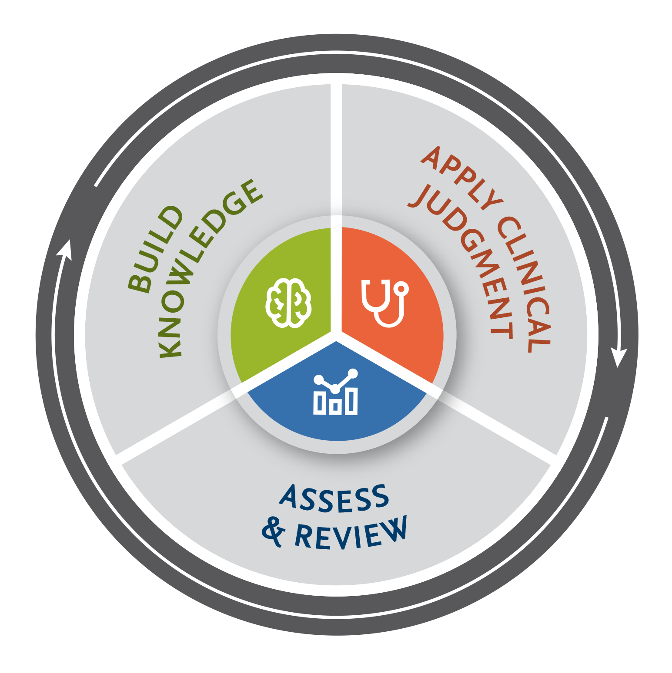
Elsevier
Total Curricular Solutions
Build Knowledge
Curricular Texts
Clinical Skills
Sherpath with EAQ
Evolve Resources
Nursing Skills Online
Assess & Review
EAQ (alone & in Sherpath
Testbanks (Evolve Resources)
HESI Exit Exams RN
HESI Virtual Live Review
AI Grading:
Clinical Skills
Sherpath with EAQ
Evolve Resources
EAQ (alone & in Sherpath
Testbanks
HESI Exit Exams RN
SimChart
HESI Case Studies
Apply Clinical Judgment
SimChart
SLS with VR
SLS
HESI Case Studies
Shadow Health
June 10, 2021

Slide 4
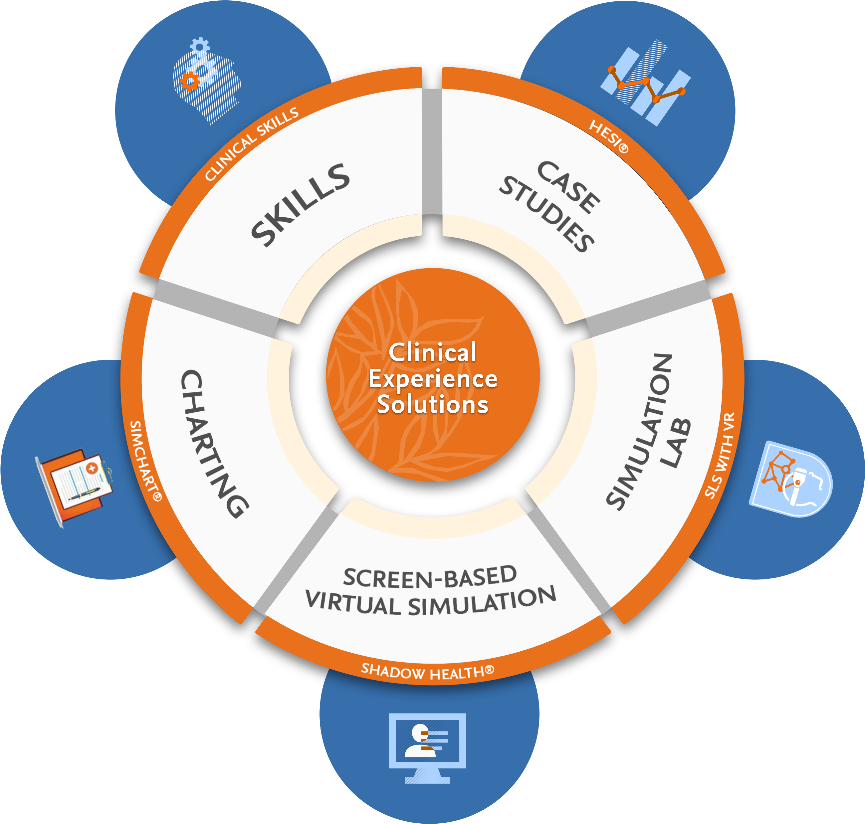
To learn more about any of these resources,
contact your Educational Solutions Consultant
Erin Carlson
e.carlson@elsevier.com
Elsevier Resources:
Northern College Breakout Session
Digital Tools You Can Implement Today
June 10, 2021

Slide 5
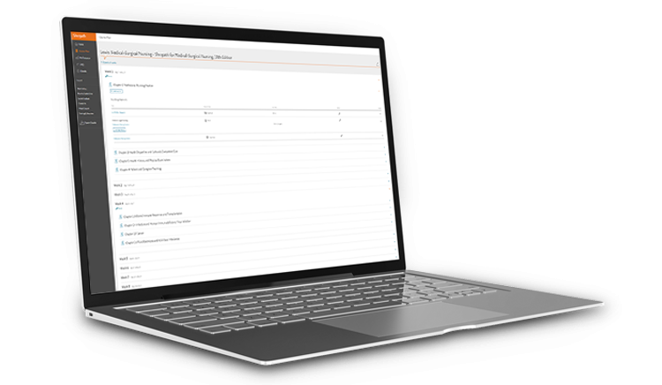
Sherpath is a personalized teaching and learning technology built specifically for healthcare education.
Digital-first content including innovative
adaptive learning techniques
Holistic learning analytics allow students & instructors to understand, in real-time, how they are tracking towards core competencies
Fully interconnected course content delivered in a single interface
Multi-dimensional ecosystem providing various integrated learning resources, lessons, assessments & virtual simulations
Actionable, evidence-based insights allows intervention at the student, course and programmatic level driving meaningful, positive outcomes

Slide 6
Setting programs, educators, and students up for success.
Elsevier's comprehensive curriculum solutions provide the authoritative content, state-of-the-art technology, and insightful data you need to achieve positive program outcomes and prepare students for successful healthcare careers.
Training & Tutorials
Elsevier Education Site
https://evolve.elsevier.com/education/
June 10, 2021

Slide 7
Evolve Link provides an easy way to link content from Elsevier products and resources directly into your institution's learning management system (LMS). Compatible LMSs include Blackboard Learn™, Canvas, Moodle™, and Brightspace by D2L.
LMS Integration
Educator Training & Implementation
https://evolve.elsevier.com/education/training/evolve-link/
June 10, 2021

Slide 8
Support
Evolve Support Online http://evolvesupport.elsevier.com
Chat
Email
Phone
Phone: +1 800 222 9570
Monday-Friday: 7am-11pm CST
Saturday: 8am-6pm CST
Sunday: 12pm-10pm CST
Blackboard Integration and Digital Resource Support:
Dedicated Digital Implementation Specialist
Robert Taylor
r.taylor.1@elsevier.com
June 10, 2021

Slide 9
Helpful Links
Educational Solutions Consultant: Erin Carlson e.carlson@elsevier.com
Digital Implementation Specialist: Robert Taylor r.taylor.1@elsevier.com
Elsevier Education Site: https://evolve.elsevier.com/education
Educator Training & Implementation: https://evolve.elsevier.com/education/training/evolve-link
Evolve Support Online http://evolvesupport.elsevier.com
Evolve Support Phone: +1 800 222 9570

Slide 10
Q&A
Edit Master text styles

